Slide 1
LECTURE 7 outline
3.1 Transport-layer services
3.2 Multiplexing and demultiplexing
3.3 Connectionless transport: UDP
Flow Control Techniques

Slide 2












Transport services and protocols
application
provide logical communication between app processes running on different hosts
transport protocols run in end systems
send side: breaks app messages into segments, passes to network layer
rcv side: reassembles segments into messages, passes to app layer
more than one transport protocol available to apps
Internet: TCP and UDP
transport
network
data link
physical
logical end-end transport
application
transport
network
data link
physical

Slide 3
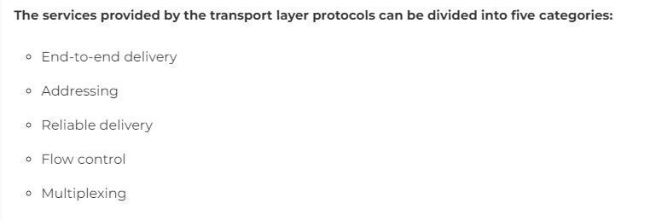
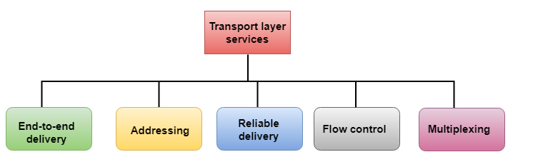

Slide 4
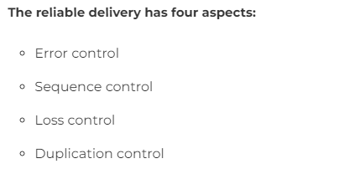

Slide 5
Transport vs. network layer
network layer: logical communication between hosts
transport layer: logical communication between processes
relies on, enhances, network layer services
Household analogy:
12 kids sending letters to 12 kids
processes = kids
app messages = letters in envelopes
hosts = houses
transport protocol = Ann and Bill
network-layer protocol
= postal service

Slide 6

Internet transport-layer protocols
reliable, in-order delivery (TCP)
congestion control
flow control
connection setup
unreliable, unordered delivery: UDP
no-frills extension of “best-effort” IP
services not available:
delay guarantees
bandwidth guarantees
application
transport
network
data link
physical
network
data link physical
network
data link physical
logical end-end transport
network
data link
physical_{network}
data link
physical
network
data link physical
application
network
transport
data link physical
network
data link
physical

Slide 7
Chapter 3 outline
3.1 Transport-layer services
3.2 Multiplexing and demultiplexing
3.3 Connectionless transport: UDP
3.4 Principles of reliable data transfer
3.5 Connection-oriented transport: TCP
segment structure
reliable data transfer
flow control
connection management
3.6 Principles of congestion control
3.7 TCP congestion control

Slide 8
Multiplexing/demultiplexing
Demultiplexing at rcv host:
Multiplexing at send host:
delivering received segments to correct socket
gathering data from multiple sockets, enveloping data with header (later used for demultiplexing)
= socket
= process
P3
P1
P2
P4
application
application
P1
application
transport
transport
transport
network
network
network
link
link
link
physical
physical
physical
host 1
host 2
host 3

Slide 9
Chapter 3 outline
3.1 Transport-layer services
3.2 Multiplexing and demultiplexing
3.3 Connectionless transport: UDP
3.4 Principles of reliable data transfer
3.5 Connection-oriented transport: TCP
segment structure
reliable data transfer
flow control
connection management
3.6 Principles of congestion control
3.7 TCP congestion control

Slide 10
UDP: User Datagram Protocol [RFC 768]
“no frills,” “bare bones” Internet transport protocol
“best effort” service, UDP segments may be:
lost
delivered out of order to app
connectionless:
no handshaking between UDP sender, receiver
each UDP segment handled independently of others
Why is there a UDP?
no connection establishment (which can add delay)
simple: no connection state at sender, receiver
small segment header
no congestion control: UDP can blast away as fast as desired

Slide 11
UDP: more
often used for streaming multimedia apps
loss tolerant
32 bits
Length, in
source port #
dest port #
rate sensitive
other UDP uses
DNS
SNMP
bytes of UDP
length
checksum
segment, including header
Application data (message)
reliable transfer over UDP: add reliability at application layer
application-specific error recovery!
UDP segment format

Slide 12
UDP checksum
Goal: detect “errors” (e.g., flipped bits) in transmitted segment
Sender:
treat segment contents as sequence of 16-bit integers
checksum: addition (1’s complement sum) of segment contents
sender puts checksum value into UDP checksum field
Receiver:
compute checksum of received segment
check if computed checksum equals checksum field value:
NO - error detected
YES - no error detected. But maybe errors nonetheless? More later
….

Slide 13
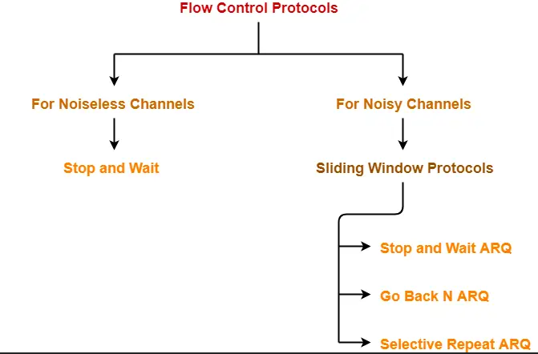
Flow Control
In computer networks, flow control is defined as - A set of procedures which are used for restricting the amount of data that a sender can send to the receiver.
Flow Control Protocols-

Slide 14
Stop and Wait Protocol-
Stop and Wait Protocol is the simplest flow control protocol.
It works under the following assumptions-
Communication channel is perfect.
No error occurs during transmission.
Working
Sender sends a data packet to the receiver.
Sender stops and waits for the acknowledgement for the sent packet from the receiver.
Receiver receives and processes the data packet.
Receiver sends an acknowledgement to the sender.
After receiving the acknowledgement, sender sends the next data packet to the receiver.

Slide 15
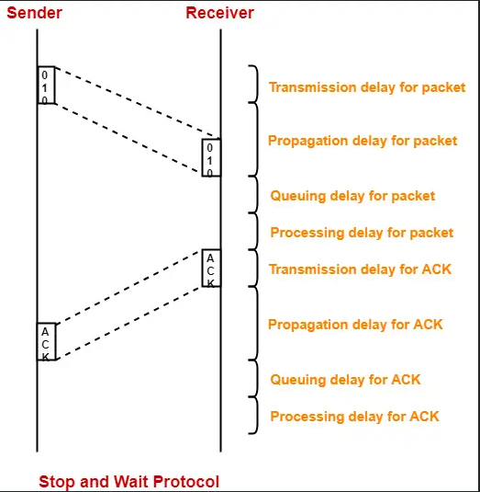
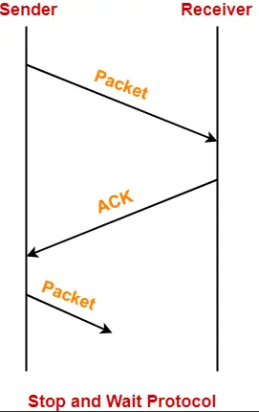

Slide 16
Total time taken in sending one data packet
= (Transmission delay + Propagation delay + Queuing delay + Processing delay)packet
+
(Transmission delay + Propagation delay + Queuing delay + Processing delay)ACK
Assume Queuing delay and processing delay to be zero at both sender and receiver side.
Transmission time for the acknowledgement to be zero since it’s size is very small.
Under the above assumptions.
Total time taken in sending one data packet
= (Transmission delay + Propagation delay)packet + (Propagation delay)ACKWe know,
Propagation delay depends on the distance and speed. So, it would be same for both data packet and acknowledgement.
So, we have-
Total time taken in sending one data packet
= (Transmission delay)packet + 2 x Propagation delay

Slide 17
Efficiency-
Efficiency of any flow control control protocol is given by-
Efficiency (η) = Useful Time / Total Time
where-
Useful time = Transmission delay of data packet = (Transmission delay)packet
Useless time = Time for which sender is forced to wait and do nothing = 2 x Propagation delay
Total time = Useful time + Useless time

Slide 18
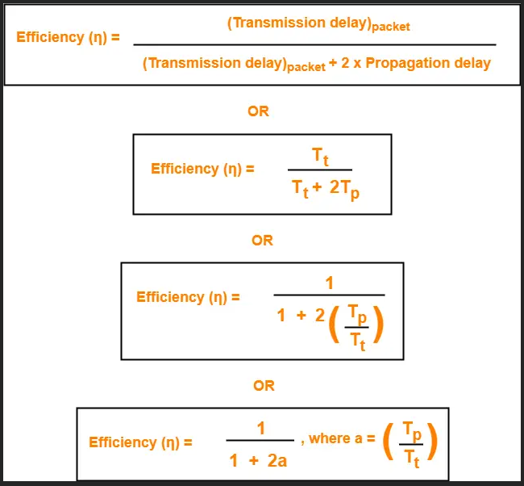

Slide 19
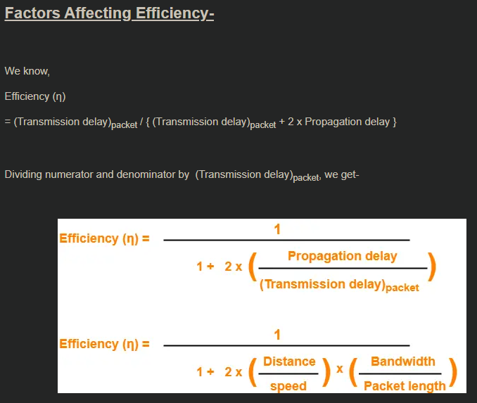

Slide 20
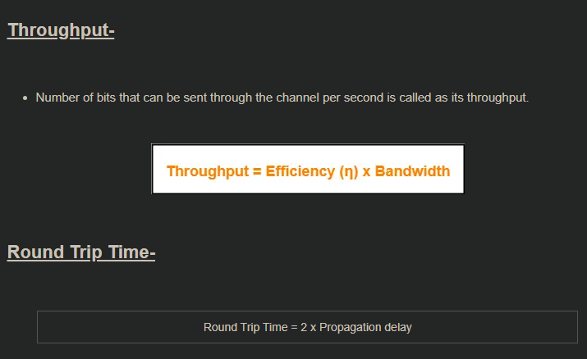

Slide 21
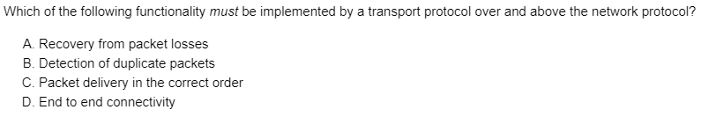

Slide 22
